Slide 1

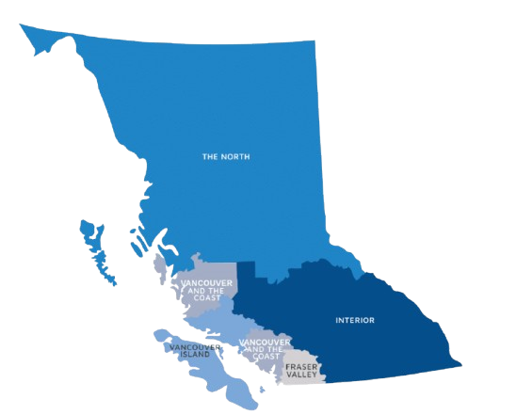



BC Surgical Wait Times
A Data-Driven Analysis of Surgical Wait Times
M2M Tech | DataTalent | Capstone Project - 1
Muthukannan Gomathisamynathan

Slide 2
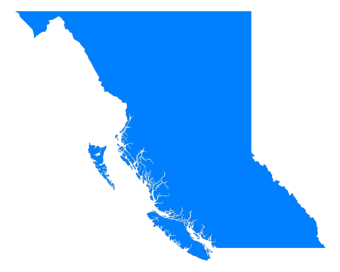
Large Image slide
Table of content
Idea and Purpose
Data Acquisition & Tools
Data Preparation
EDA & Data Analysis
Insights
Conclusion & Future Plan
Notes:
© Copyright Showeet.com – Free PowerPoint Templates

Slide 3

Large Image slide
Idea and Purpose
Canadian HealthCare is one of the best in the world. Yet the common complaint regarding the higher wait times is often discussed in Social Media.
Parallelly, one of the tik-tokers made a video saying the population growth is the main reason and many seconded it.
So, the pragmatic way of validating is analysing the data. To start with, I choose my home Province British Columbia as ground with few questions.
Is the Population growth really impacting the Wait times?
Which City is handling the wait times better?
Which Health Authority is the managing better so that others can use their methods?
Can we predict the wait times to plan early on building the infrastructure?
Notes:
© Copyright Showeet.com – Free PowerPoint Templates

Slide 4






Large Image slide
Data Acquisition & Tools
The Data is gathered from the BC Government website and Canada Open Government data
DataSet#1: BC Surgical wait times 2009 – 2024
https://open.canada.ca/data/en/dataset/7c1bf2a8-96bb-4ad5-888d-a90672eb306e/resource/896facf1-f379-413d-bcc7-b90259f329be
DataSet#2: 2001-2011 Population Data -
https://www2.gov.bc.ca/assets/gov/data/statistics/people-population-community/population/pop_municipal_subprov_areas_2001_2011.xlsx
DataSet#3: 2011-2024 Population Data
https://www2.gov.bc.ca/assets/gov/data/statistics/people-population-community/population/pop_municipal_subprov_areas.xlsx
Tools:
VS Code
Jupyter
Numpy, Pandas
Bokeh
Notes:
© Copyright Showeet.com – Free PowerPoint Templates

Slide 5
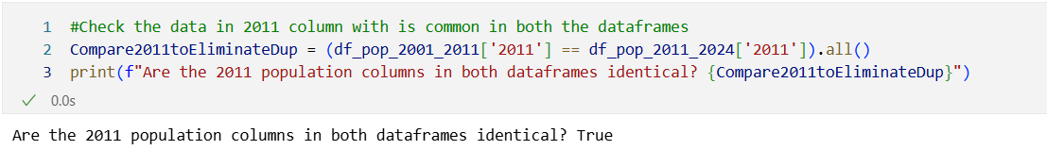
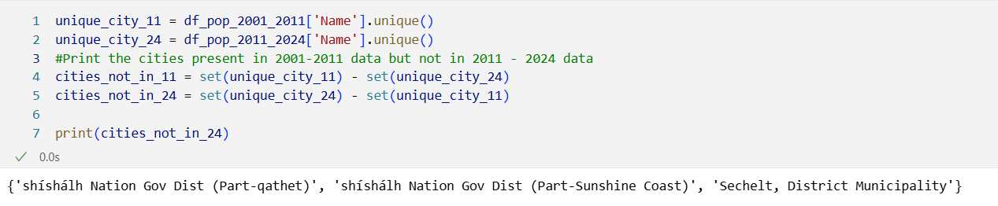
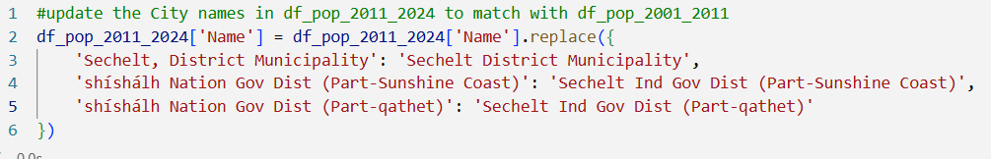
Large Image slide
Data Preparation
The Surgical Wait times data has data from 2009 to 2024. The Population data set is split into files – 2001 to 2011 and 2011 to 2024. So it is merged it into one.
After loading the Excel sheets to Data frame, we can see the 2011 Population is common in both. In order to drop that we have to see if it is same in both Data frames.
We drop the 2011 data. Then we see if there is any mismatch in the City names to join them based on City and update them.
Notes:
© Copyright Showeet.com – Free PowerPoint Templates

Slide 6

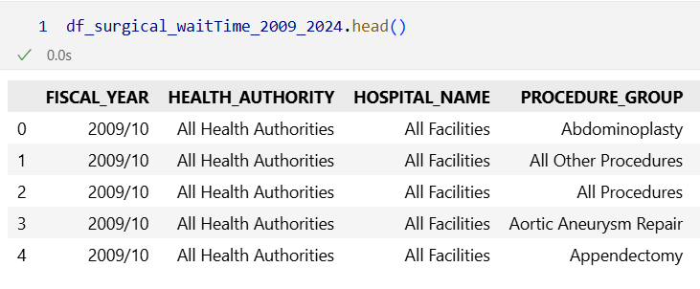
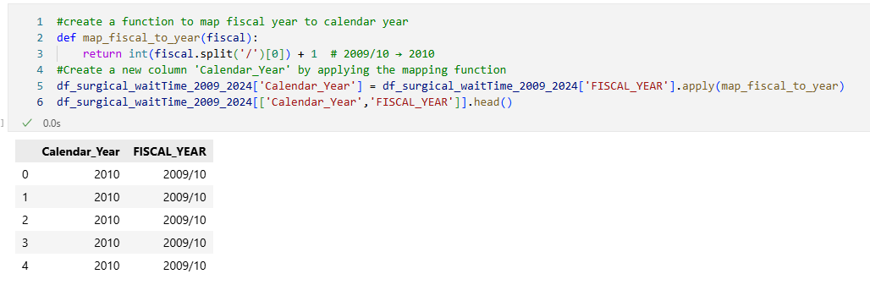
Large Image slide
Data Preparation (cont..)
We also dropped the columns that are not significant and combined the data based on City name.
After we load the surgical wait times, drop the non significant columns, and see the data is based on Fiscal Year. So creating a new Column Calendar year to combine with the Population Data.
Notes:
© Copyright Showeet.com – Free PowerPoint Templates

Slide 7
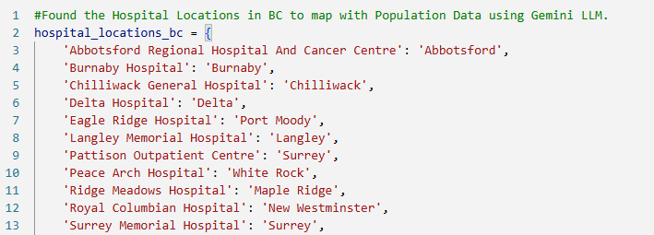
Large Image slide
Data Preparation (cont..)
Also, we don’t have CITY details in the Surgical wait times. We are updating the City name based on the Hospitals.
After cleaning the CITY names, and Combining the data for Cities like Langley City and Langley Township, and converting the Population data in Long format, we can merge them to a single Data Frame.
Extracted the cleaned data in a parquet file to load it in the new Notebook
Notes:
© Copyright Showeet.com – Free PowerPoint Templates

Slide 8
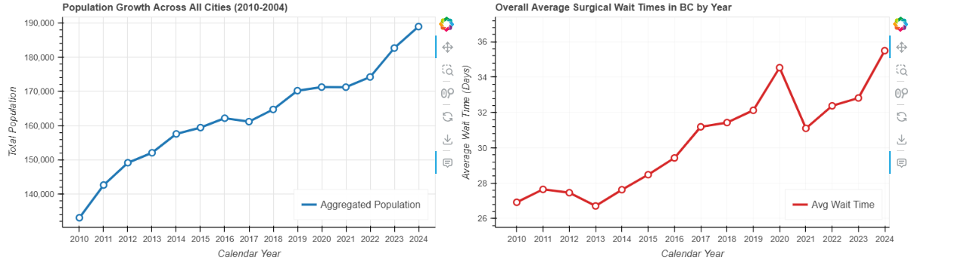
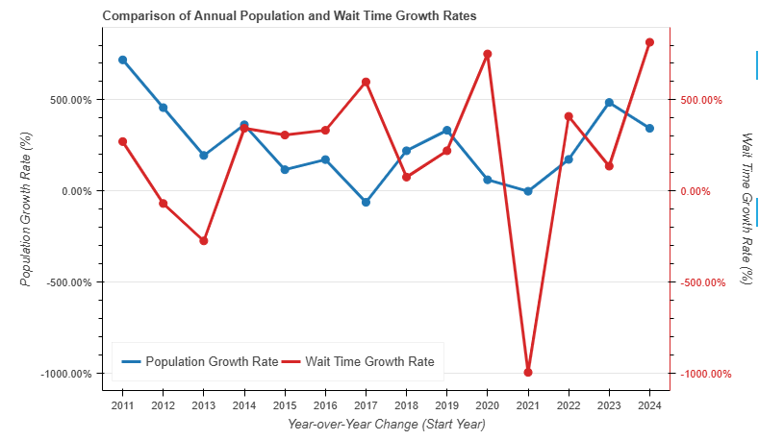
Large Image slide
EDA & Data Analysis
We compare the Mean Surgical Wait time and Mean Population over the years. The chart looks more similar but it doesn’t bring the clear insight on the question if Population growth affects wait times.
So, We compare the Average Population growth and Average Wait Times over the years
Notes:
© Copyright Showeet.com – Free PowerPoint Templates

Slide 9
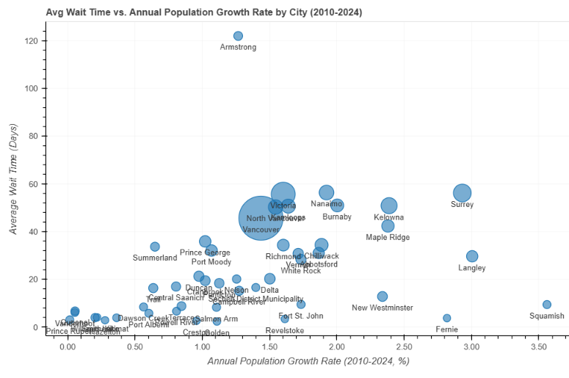
Large Image slide
EDA & Data Analysis (cont..)
We created a bubble chart to see which City performed better with the Population Growth.
Notes:
© Copyright Showeet.com – Free PowerPoint Templates

Slide 10
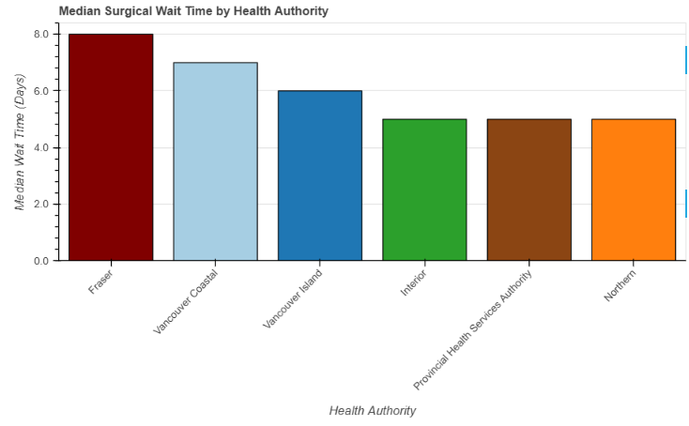
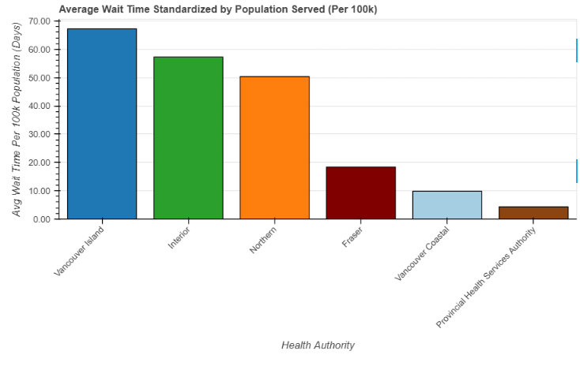
Large Image slide
EDA & Data Analysis (cont..)
We can also find which Health Authority is having Higher wait times.
Though it shows Fraser Health and Vancouver Costal has higher wait times, we know that they are areas with larger population. So we need to Standardize the population served to derive the right data.
Notes:
© Copyright Showeet.com – Free PowerPoint Templates

Slide 11
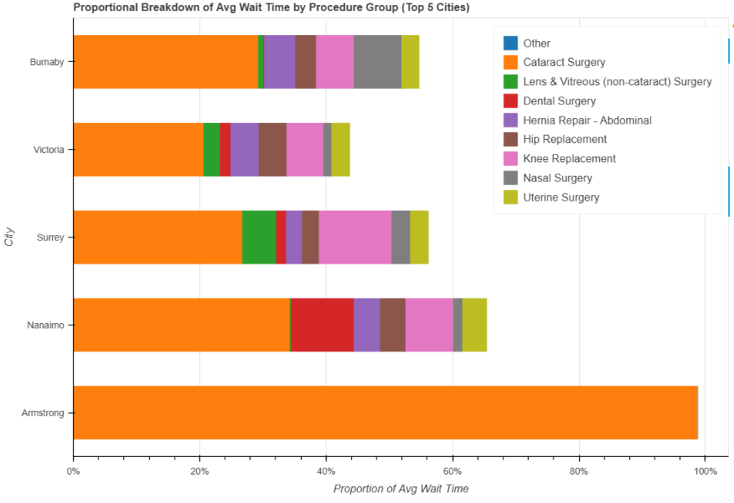
Large Image slide
EDA & Data Analysis (cont..)
From Previous analysis we have the top 5 cities with more wait time. To dig deeper we can find out which Procedures are causing more wait times.
Notes:
© Copyright Showeet.com – Free PowerPoint Templates

Slide 12




Large Image slide
Insights
Population:
Population Growth is NOT the primary driver of changes in wait times.
2017 and 2023 shows the Population growth and wait times move in opposite directions.
2020-2021 which is the COVID-19 period shows chaotic change in the Wait times which is an outlier.
Cities:
Squamish, Langley and Fernie are performing better even with higher Average population growth.
Amstrong has a lot to improve with wait times.
While Vancouver is doing pretty good staying in the middle even when performing the highest number of surgeries.
Notes:
© Copyright Showeet.com – Free PowerPoint Templates

Slide 13
Large Image slide
Population:
Population Growth is NOT the primary driver of changes in wait times.
2017 and 2023 shows the Population growth and wait times move in opposite directions.
2020-2021 which is the COVID-19 period shows chaotic change in the Wait times which is an outlier.
Insights
Cities:
Squamish, Langley and Fernie are performing better even with higher Average population growth.
Amstrong has a lot to improve with wait times.
While Vancouver is doing pretty good staying in the middle even when performing the highest number of surgeries.
Health Authority:
Provincial health Service Authority is the top performer and Vancouver Island has scope of improving the wait times.
Notes:
© Copyright Showeet.com – Free PowerPoint Templates

Slide 14
Large Image slide
Cities:
Squamish, Langley and Fernie are performing better even with higher Average population growth.
Amstrong has a lot to improve with wait times.
While Vancouver is doing pretty good staying in the middle even when performing the highest number of surgeries.
Insights
Health Authority:
Provincial health Service Authority is the top performer and Vancouver Island has scope of improving the wait times.
Procedures:
Cataract, Lens & Vitreous Surgeries seems to be the one that people in the top cities are waiting for Suggesting that we need more Ophthalmic surgeon.
Notes:
© Copyright Showeet.com – Free PowerPoint Templates

Slide 15
Large Image slide
Health Authority:
Provincial health Service Authority is the top performer and Vancouver Island has scope of improving the wait times.
Insights
Procedures:
Cataract, Lens & Vitreous Surgeries seems to be the one that people in the top cities are waiting for Suggesting that we need more Ophthalmic surgeon.
Notes:
© Copyright Showeet.com – Free PowerPoint Templates

Slide 16

Large Image slide
Conclusion & Future Plan
We need to add more data such as Hospital capacity, Doctors/Surgeon availability etc.,
Interactive Dashboard and Executive summary has to be added to the Analysis
Incorporate Advanced statistical Modelling/Machine Learning to predict the wait times
Notes:
© Copyright Showeet.com – Free PowerPoint Templates

Slide 17




THANK YOU
Muthukannan Gomathisamynathan
https://linkedin.com/gmuthukannan
https://github.com/gmuthukannan

